Slide 1
Business Intelligence Suite 2.0
Notes & Guides
Houston, TX
Updated July 26, 2016

Slide 2
Database Strategy: Split Database
End User’s get a ‘light’ Front End database

Slide 3
Connectivity
To use Prism, you need:
Connectivity to the Brock Network
To be assigned to the Brock IT “User Group”: ORG-BSL-DP-BBI
(1 & 2) will allow you access to the server \\DPHQ-FS-01\BBI which is the directory/path that houses Prism
Once you have access noted in #2, your local work station needs to be ‘mapped’ to the server/directory noted in #3. This is setting up the server path under a ‘lettered’ drive on your local desktop/laptop.
The below note to the IT Help Desk is all they need to know to take care of you.
“Please add the me to the user group: ORG-BSL-DP-BBI, and I need my workstation mapped network folder \\DPHQ-FS01\BBI\ (preferably through the “G” drive, but anything will work).
Brock IT can assist you in Steps #1-5.

Slide 4
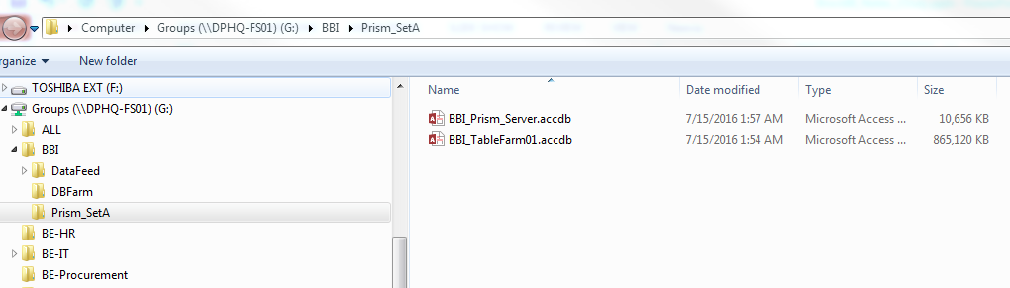
Download the Latest Prism
The ‘Front-End’ database is intended to be downloaded and kept on your local work station.
As we are continuing to develop the program, you will need to pull down a new “Prism” frequently from the server.
Below is a screen shot of the ‘path’ to the file. The only difference on your computer will be the ‘lettered’ drive that the server is mapped to.
Download this
Link to this
Prism2.0.accdb
BBI_Backend_01.accdb

Slide 5
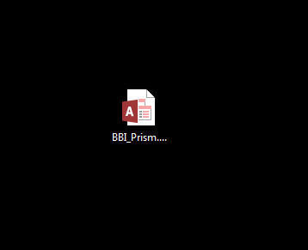
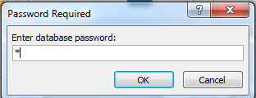
Link Prism to the Backend Database:
All users should already be assigned to user group: ORG-BSL-DP-BBI, which gives you access to the network folder at \\DPHQ-FS01\BBI\
If that is not the case, then you should put in a Help Ticket through Brock IT. This is the only support provided by Brock IT.
The network folder may be mapped to any ‘lettered’ drive on your desktop (i.e.: G:, Y:, Z:). The Prism application is configured to look for the ‘Backend’ database through a certain pathway on the “G:” drive. If the network folder is not mapped this specific way, you can manually change the linkage in your local copy of Prism make the proper connection.
Open your local copy of Prism from your desktop.

Slide 6
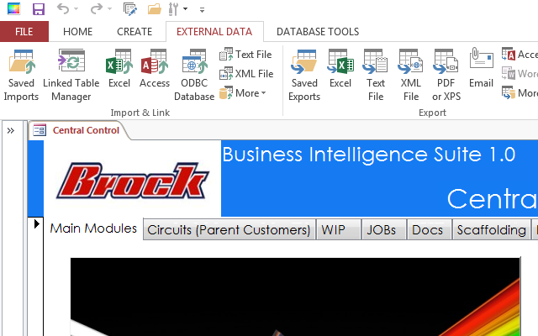
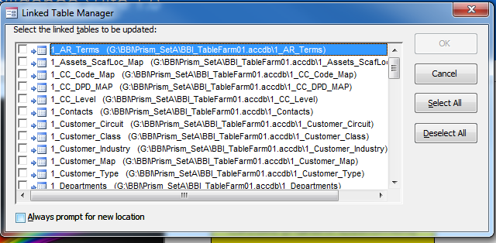
Link Prism to the Backend Database : - cont’d
A
B
Under “External Data”, Select the “Linked Table Manager”:
A. Click the “Select All” button on the right
B. Check the “Always Prompt....” box at the bottom
C. Select “OK”
C
A
B

Slide 7
Link Prism to the Backend Database : - cont’d
A Window’s Explorer box will pop up.
A. Select the Drive that the DPHQ-FS01 server is mapped to (i.e. G, Y, Z, etc..)
B. Going down that folder’s path, find and single click the Backend Database that you should be mapped to: (the new default is shown: BBI_Backend_01)
C. Select Open.
A
B
C
Until told otherwise, everyone’s default “Backend Database” should be: BBI_Backend_01.
The network path is \\DPHQ-FS-01\BBI\Prism_SetA\BBI_Backend_01.accdb

Slide 8
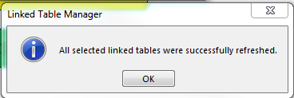
Link Prism to the Backend Database : - cont’d
You should receive this message when the table links refresh successfully.

